Slide 1


Team Code Fellas

Slide 2
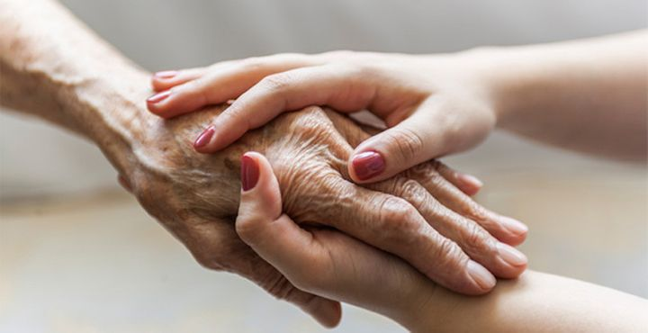
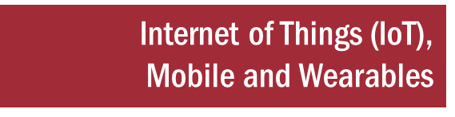

SNF Assist

Slide 3





ABOUT THE Team
Nancy Arora
ASSC DATA ANALYST
| Noida | APAC-1 Tech-EEPS
Deepak Gupta
DATA ANALYST
| Noida | APAC-1 Tech-EEPS
Shwetank Agarwal
ASSC DATA SCIENTIST
| Noida | APAC-1 Tech-EEPS
Anand Mohan Srivastava
DATA ANALYST 2
| Noida | APAC-1 Tech-EEPS
Chitrakshi Bhandari
ASSC DATA ANALYST
| Noida | APAC-1 Tech-EEPS

Slide 4



Solution Synopsis, Demonstration
PROBLEM STATEMENT AND SOLUTION
“SNF Assist” is an intelligent software program that runs on amazon echo-like devices. It helps individuals, who are suffering with or are at risk for chronic conditions, with self-monitoring of their conditions and enables a virtual in-home care giver by leveraging the speech recognition capabilities of these devices.

Slide 5

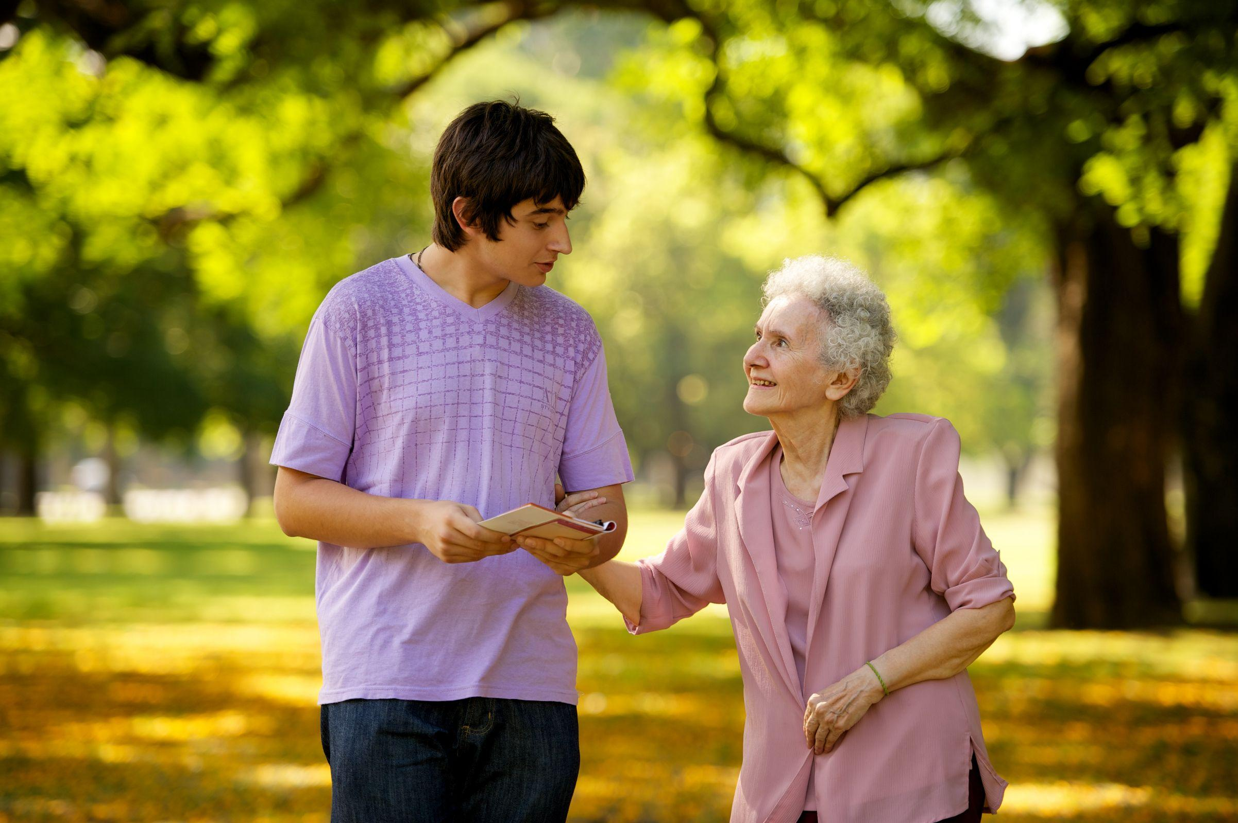
Solution Synopsis, Demonstration
what is unique about your solution, and what makes it different?
“SNF Assist” reduce health care costs to healthcare delivery to independently living elderly individuals, autistic children & patients that will enable 24 X 7 monitoring of their health and keep chronic conditions in check.

Slide 6
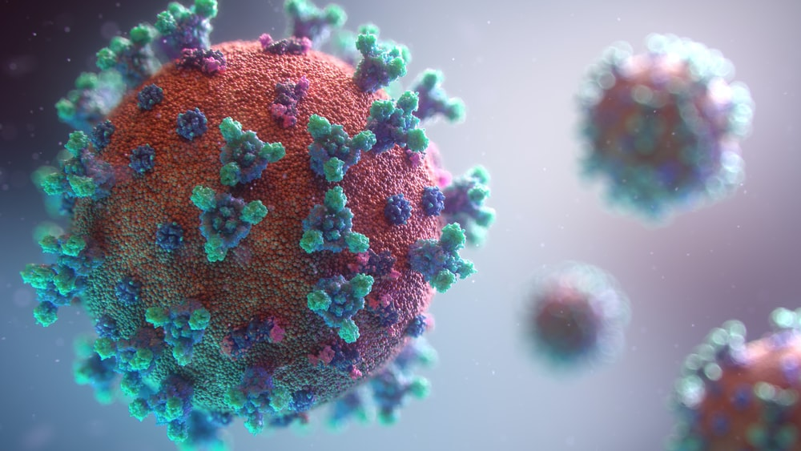

Solution Synopsis, Demonstration
What is Useful, Novel, Non-Obvious ABOUT Your Solution?
In past years we’ve observed how pandemic restricted people for inpatient facilities ,regular nursing & monitoring and frequent hospital visits. With the help of “SNF Assist”, you can avail facilities like sending your vitals to your providers at regular intervals, alarming your loved ones in emergency cases or deteriorating health conditions sitting at homes at affordable costs.

Slide 7

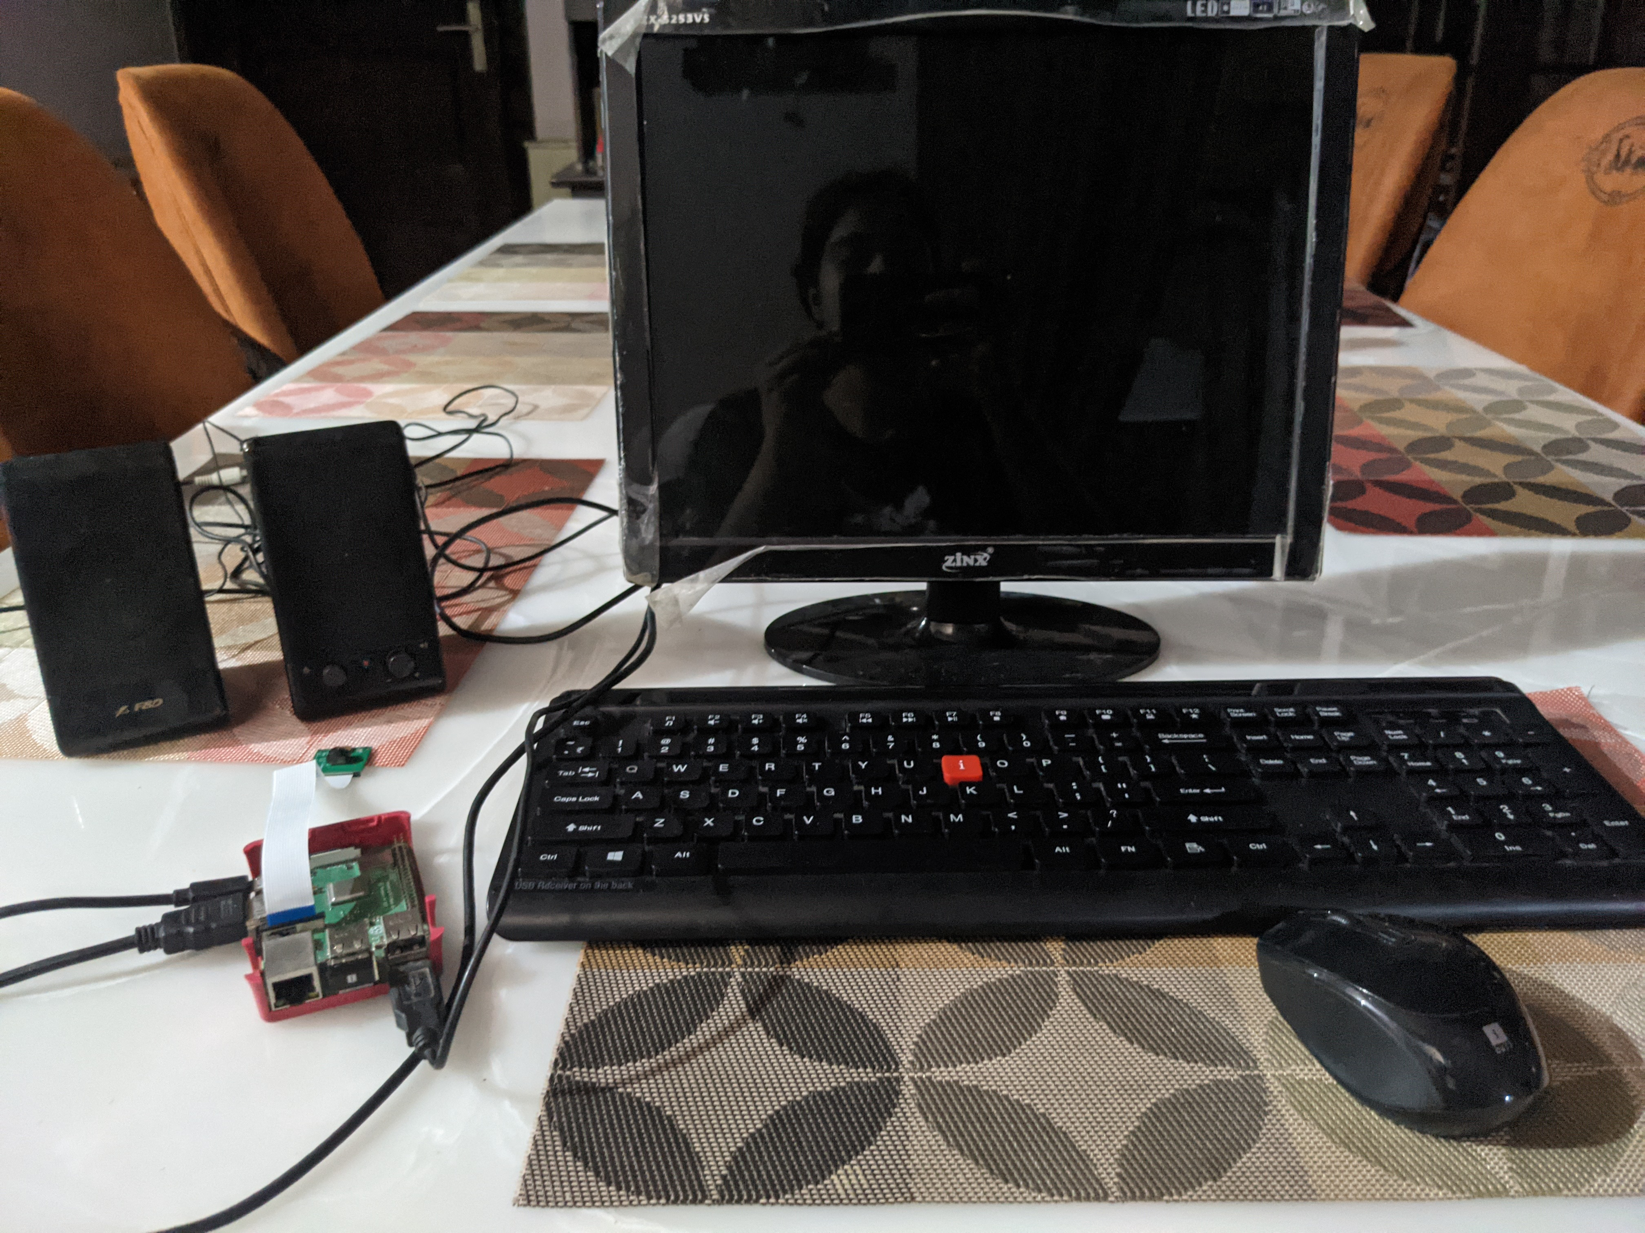

Solution Synopsis, Demonstration
How does it work?
Describe Steps to Implement your idea
We used a raspberry pi 3 and got alexa voice service to run on it by connecting a speaker and microphone. We connected our device to AWS to send/receive notifications to loved ones when the individual's health condition has deteriorated.

Slide 8



Solution Synopsis, Demonstration
What value is delivered by your solution?
Population aging, reflects a human success story of increased longevity. However, how many years can older people expect to live in good health? Can they afford the health care costs? There are certain health conditions like cancer, dementia, increase in the number of falls, obesity, and diabetes that are expected to be a challenge to our health care system. our current healthcare system is grossly unprepared to deal with the increasing aging population. A shortage of healthcare professionals is expected and there will be fewer family caregivers.

Slide 9
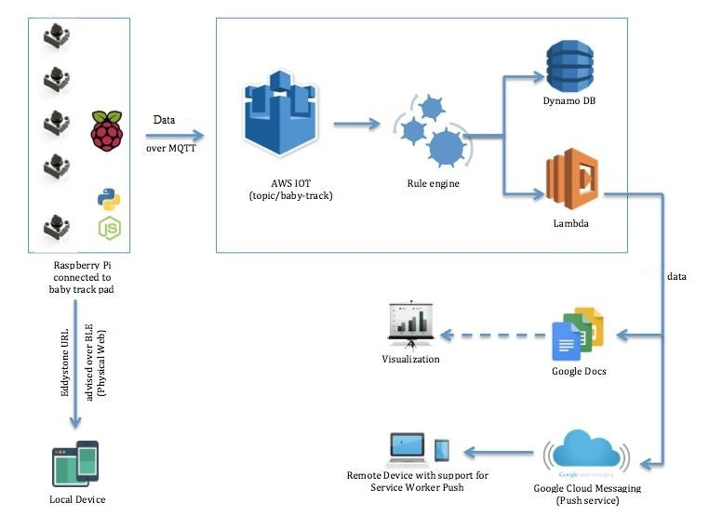
ARCHITECTURE & DATA FLOW DIAGRAM

